Slide 1

PROGETTO DI INGEGNERIA DEL SOFTWARE 2020
GC26
Federico Romeo 10566536 890975
Lorenzo Prada 10529212 869775
Riccardo Pozzan 10581128 891097

Slide 2
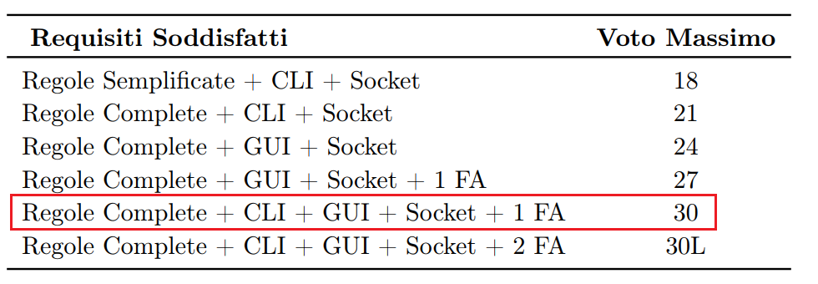
TARGET

Slide 3
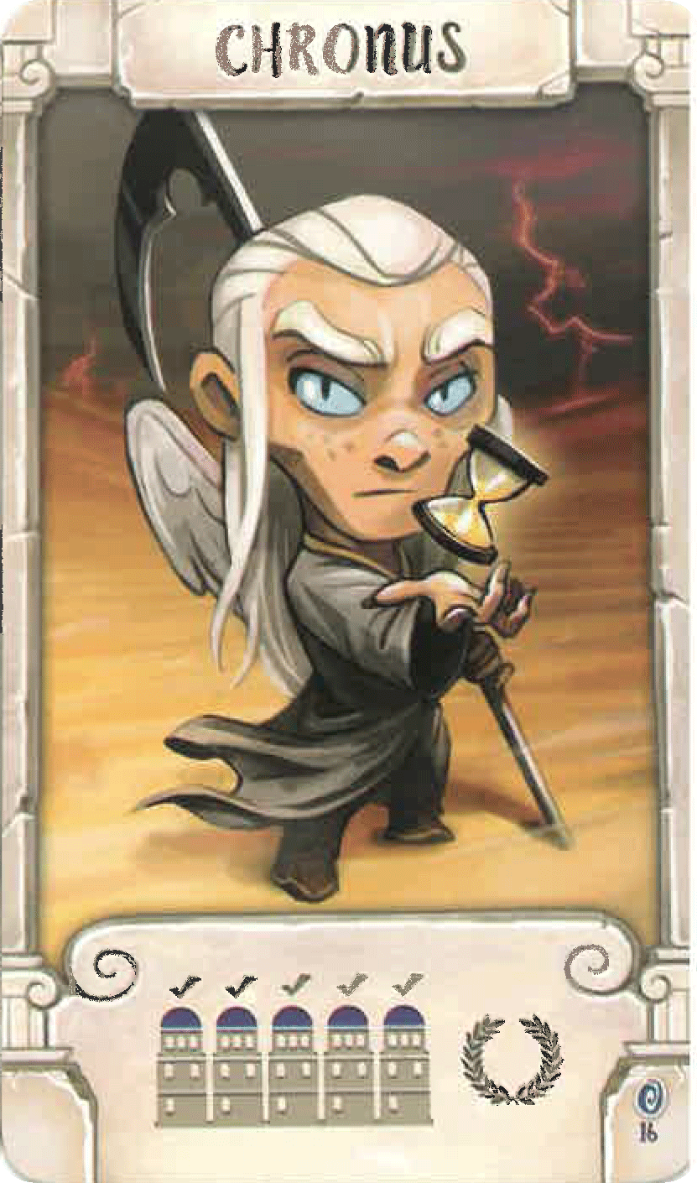
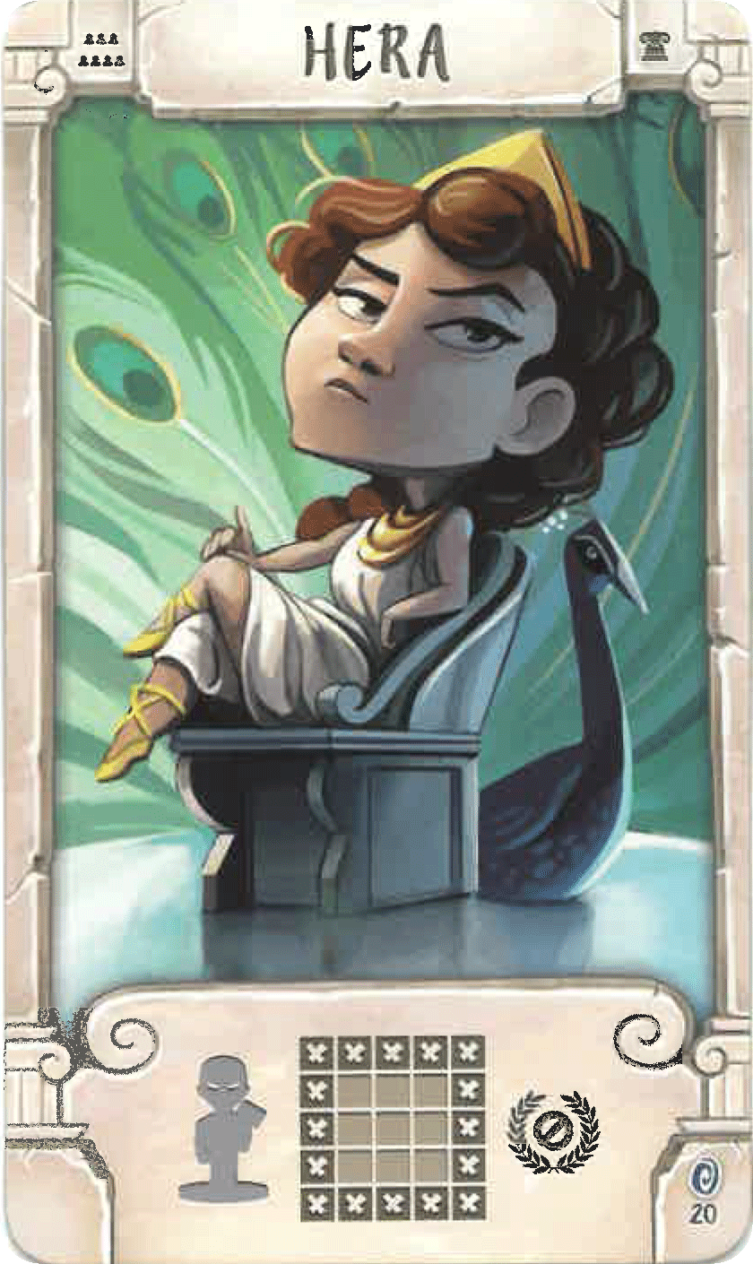
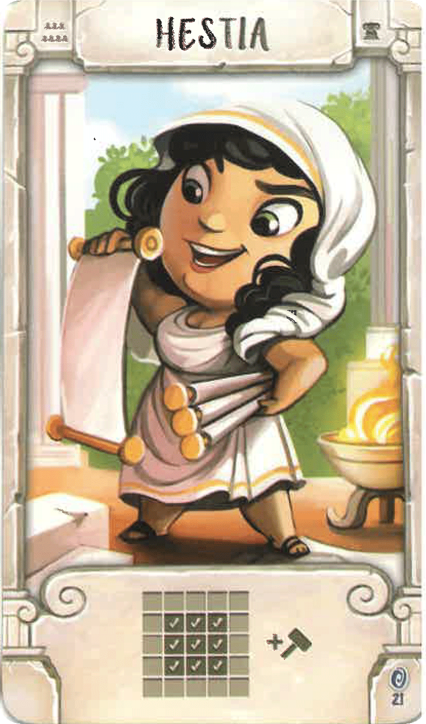
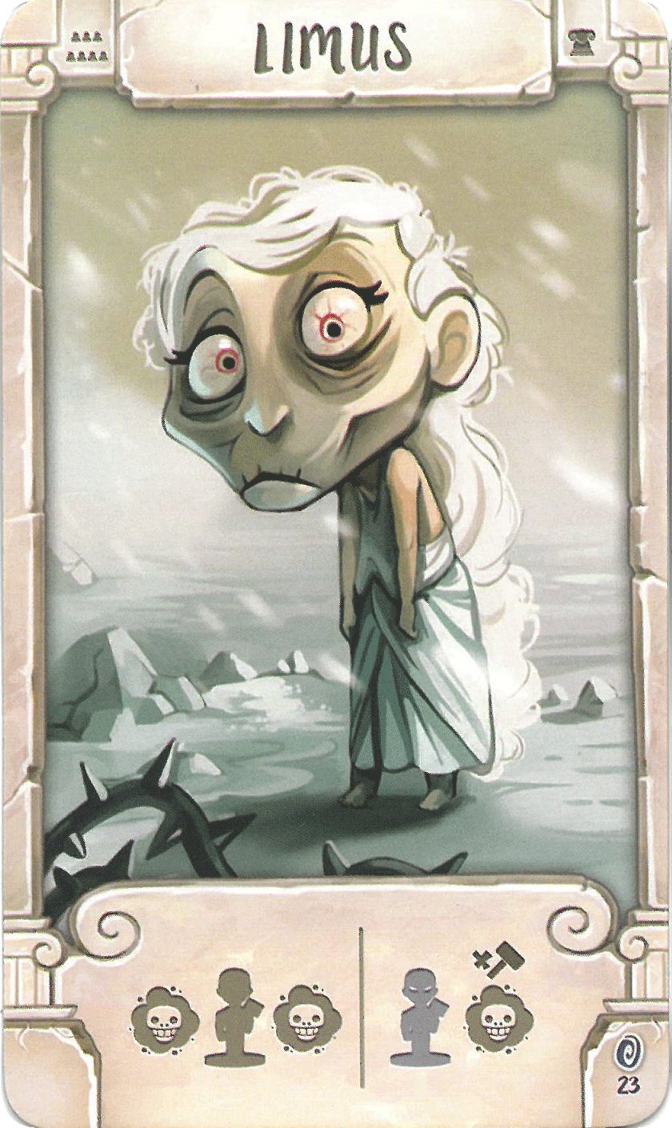
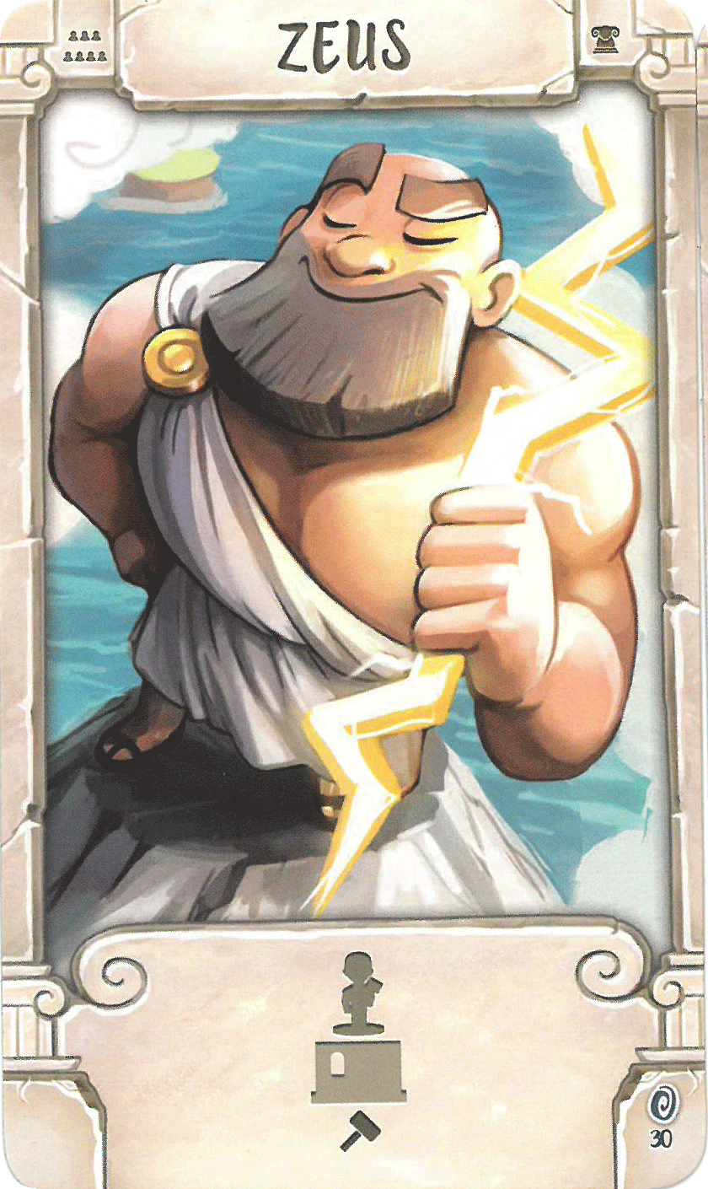
ADVANCED FUNCTIONALITIES: Advanced Gods
#16 #20 #21 #23 #30

Slide 4
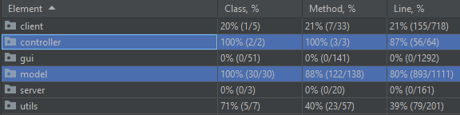
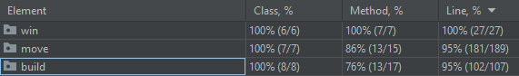
Test Coverage

Slide 5
Note:
Strategy Pattern for the implementation of the Gods’ power;
Singleton Pattern for the Server;
Singleton Pattern for the Game Battlefield;
GUI using Swing.

Slide 6
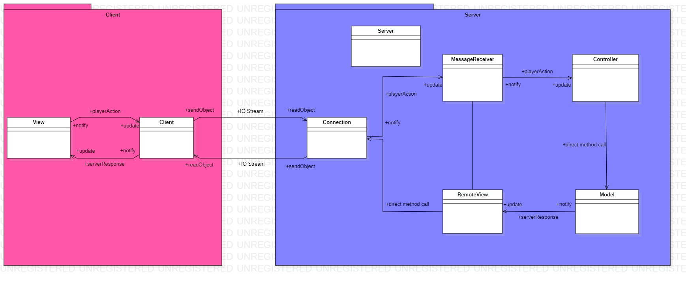
UML - client/server + MVC (high level)

Slide 7
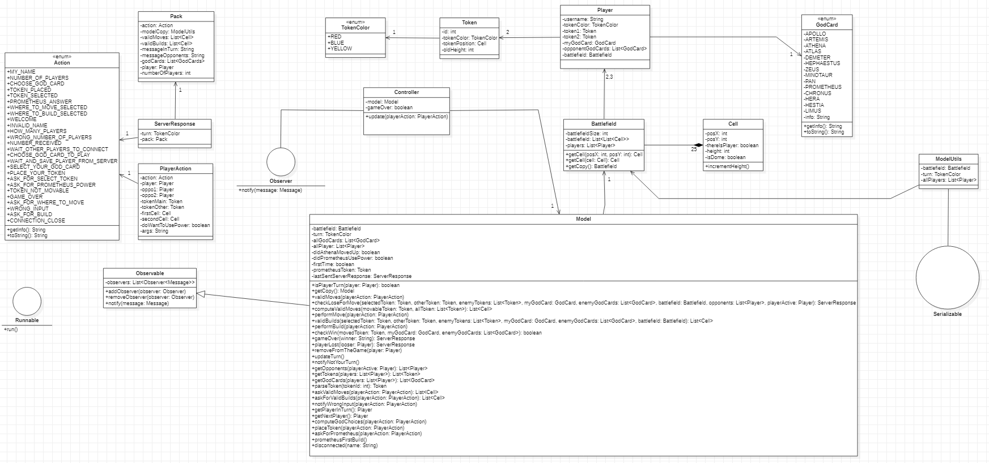
UML - Model

Slide 8
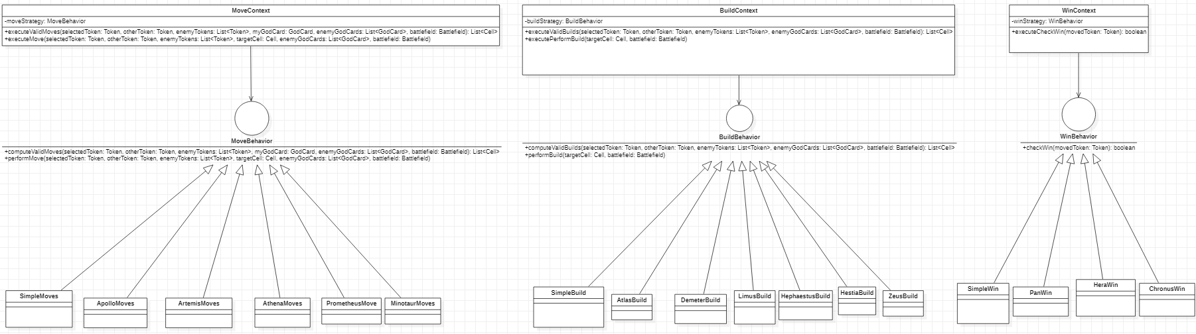
UML – Strategy Pattern
MODEL: validMoves(PlayerAction); //case: TOKEN_SELECTED
computeValidMoves(Token, GodCard, .. );
new MoveContext( new ApolloMoves() ) //moveBehaviour
.executeValidMoves()
.performMove(); //case: WHERE_TO_MOVE_SELECTED

Slide 9
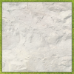
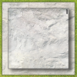


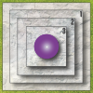






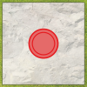








GUI - graphics
level0 level1 level2 level3 dome + varie particolari
Abbiamo creato con Illustrator grafiche per la Graphic User Interface 2d
Valid Move/Build
Dome at every level (god power)
Valid Move with a worker on it (god power)

Slide 10
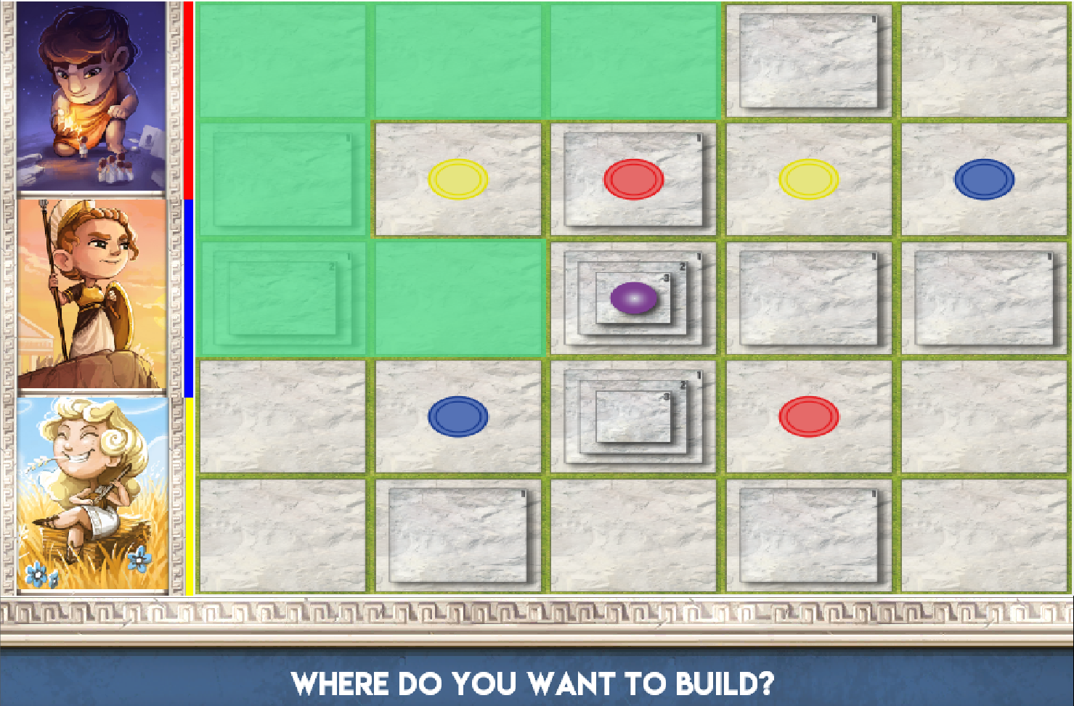
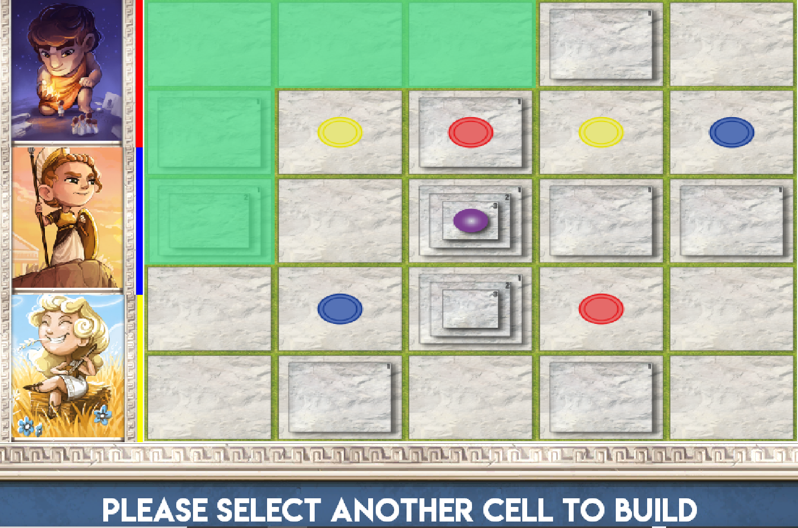
GUI – server/client decisions

